Slide 1
Pergamos
Revelation 2:12-17
Wallace, Steven J. www.revelationandcreation.com

Slide 2
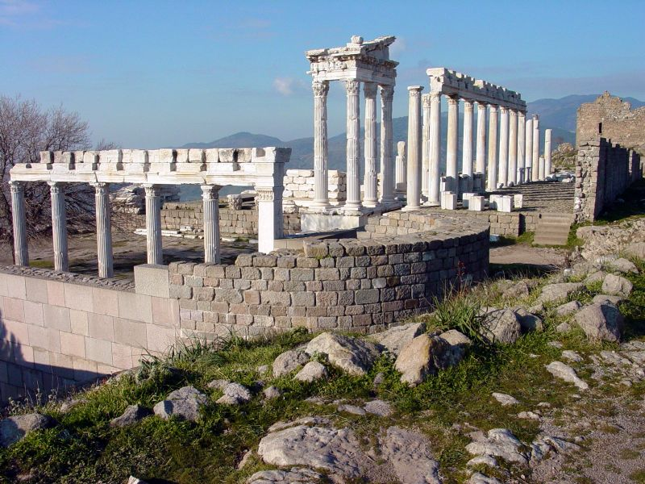
Ancient Ruins
Official Capital of Asia Minor
Pliny the governor called it the most illustrious city in Asia
Pergamos (modern-day Bergama) was the first site for temple to the Caesar-cult dedicated to Augustus, 29 B.C.
Courtesy of www.holylandphotos.org

Slide 3
Ancient Ruins
The invention of Parchment
Had a library that boasted 200,000 volumes
Ultimately, the library was moved to Egypt to be presented to Cleopatra
Courtesy of www.holylandphotos.org

Slide 4
parchment,
untanned skins of animals, especially of the sheep, calf, and goat, prepared for use as a writing material. The name is a corruption of Pergamum, the ancient city of Asia Minor where preparation of parchment suitable for use on both sides was achieved in the 2nd cent. B.C. Parchment, which is more durable than papyrus and susceptible of being folded into book form, very gradually superseded papyrus. . .The skins were soaked in water, treated with lime to loosen the hair, scraped, washed, stretched, and dried, and then rubbed with chalk and pumice stone. . .Parchment is still used for certain documents and diplomas, for book bindings and lampshades, and for the heads of drums, tambourines, and banjos.
(www.encyclopedia.com)

Slide 5
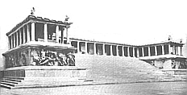
Pergamum’s Paganism
Reconstruction of the great altar
Eumenes II actively promoted the worship of Zeus and the other Olympian gods in Pergamum. He built up the great temple complex and library for which the city became famous. This was a major religious center during the Hellenistic period, and second only to Alexandria as a center of learning.

Slide 6
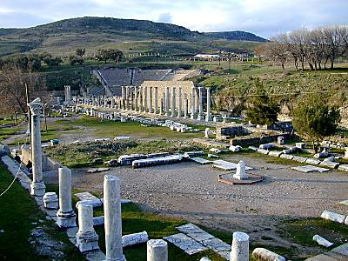
Pergamum’s Paganism
Aesculapium
Center for Aesculapius, the god of healing (constructed in 4th century B.C.)
Courtesy of www.bibleplaces.com

Slide 7
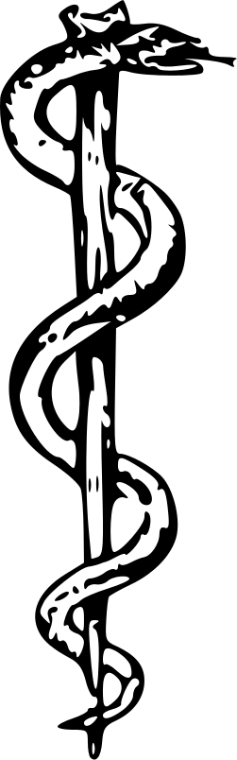
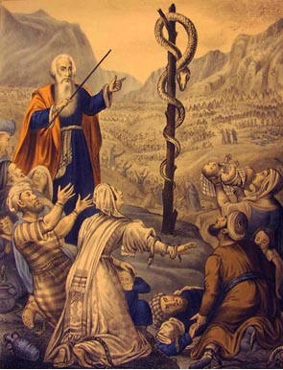
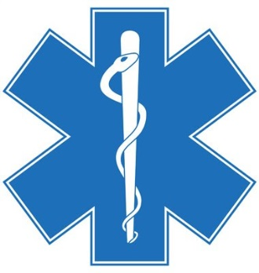
Pergamum’s Paganism
A perversion of Nehushtan?
Numbers 21:4-9
2 Kings 18:3, 4

Slide 8
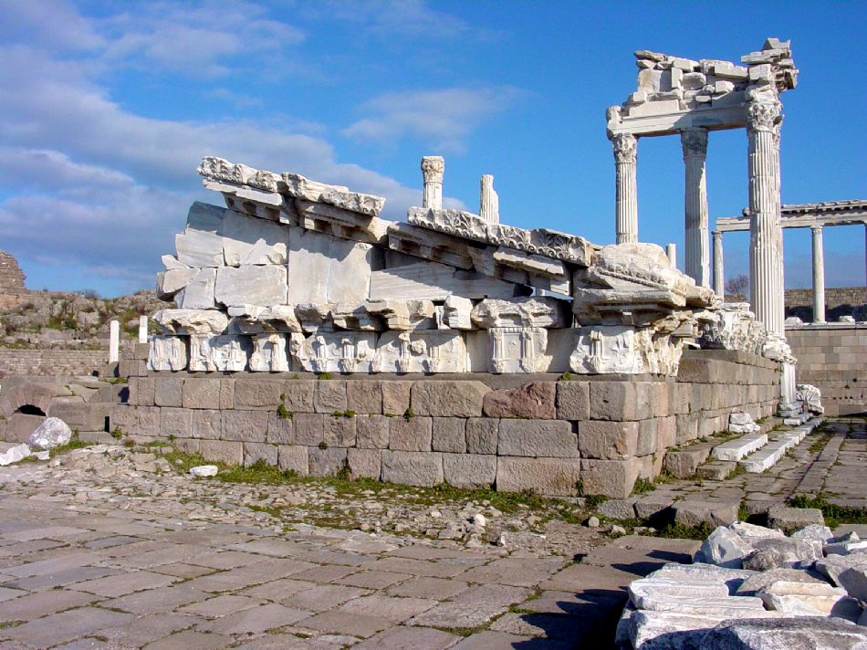
Temple of Trajan
Courtesy of www.holylandphotos.org

Slide 9
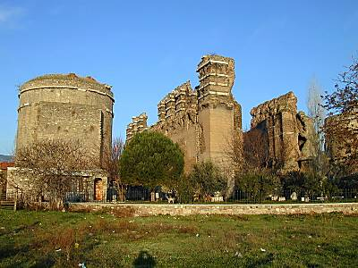
Pergamum’s Paganism
Courtesy www.bibleplaces.com

Slide 10
“Satan’s Throne” (Rev. 2:13)
A city dedicated to temples and sensuous worship
A city that referred to Zeus as “the savior”
A city that created an environment for the deeds of the Nicolaitans to flourish
A city which had the seat for emperor worship
Sadly, a city where the beacon of truth was beginning to dim and grow corrupt

Slide 11
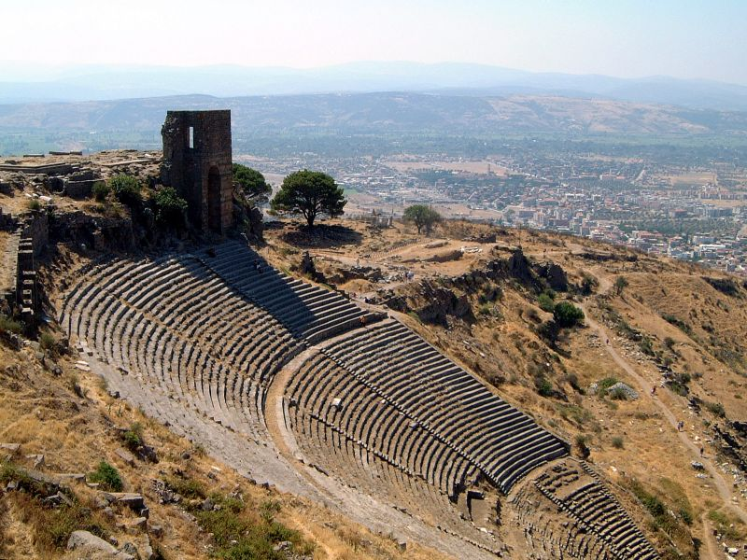
Pergamum’s Theatre
Courtesy of www.holylandphotos.org

Slide 12
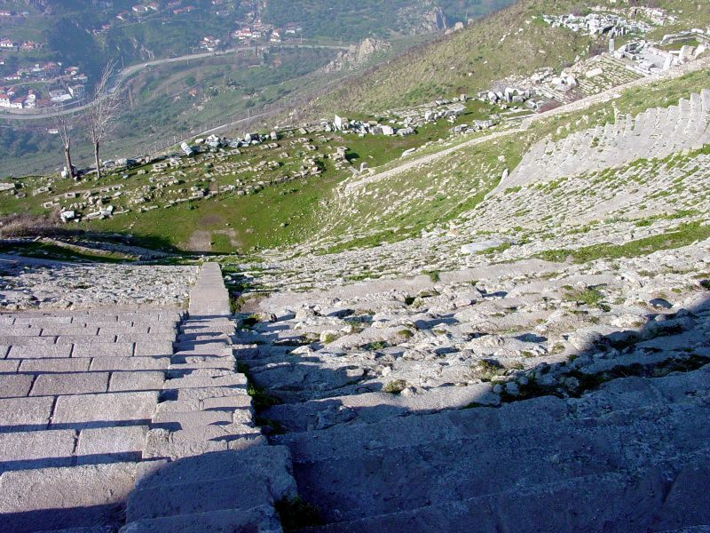
Pegamum’s Theatre
Pergamum’s Theatre
Courtesy of www.holylandphotos.org

Slide 13
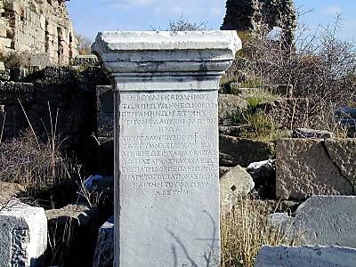
White Stone
White Stone
This white stone at Pergamum with names inscribed reminds us of Jesus' words: "And to the angel of the church in Pergamos write...He that hath an ear, let him hear what the Spirit saith unto the churches; To him that overcometh will I give to eat of the hidden manna, and will give him a white stone, and in the stone a new name written, which no man knoweth saving he that receiveth it" (Rev 2:12, 17).
Courtesy of www.bibleplaces.com

Slide 14
The Church at Pergamos
Salutation (2:12) “two-edged sword”
Divine Praise (2:13)
  Held fast the name of Christ (even among Satan’s throne.
  Did not deny the faith, even when one of their own was put to death, Antipas.
  Tradition has it that Antipas was roasted to death. He was probably the first martyr in this region.

Slide 15
The Church at Pergamos
Divine Protest (2:14, 15)
  Didn’t practice discipline
  Tolerated some who held to the doctrine of Balaam
  Tolerated some who held the doctrine of the Nicolaitans
In reference to idolatry and fornication
(Num. 31:16; 25:1-9)

Slide 16
The Church at Pergamos
Divine Prescription (2:16)
  “Repent or else” (As long as they tolerate error, they stand opposed to Jesus)
  It is implied that Jesus gave them time to repent. He gives the warning and time for repentance (v. 21)
Put away the evil one (1 Cor. 5:1-6, 13)
Repudiate those who teach strange things (Rom. 16:17, 18)
How would the church Repent?

Slide 17
The Church at Pergamos
Divine Promise/Invitation (2:17)
  Hidden Manna (spiritual nourishment)
  The white stone (innocence, purity)
  A new name. Jesus calls it “MY” new name in 3:12

Slide 18
New Name
“It may be in some way the means by which God will receive those who gain the victory. Since it cannot be known by others, it is useless to ask what it is. It is our business to overcome, the white stone and the new name we can leave to God to make plain in his own time.”
Hinds, John T. A Commentary on the Book of Revelation. Nashville, Tenn.: Gospel Advocate, p. 46.

Slide 19
New Name
“It is a sign of ownership, and a mark of citizenship. So followers of the Beast are tagged with the Mark of their Master (13:16,17). Each of us belongs to the Lord or to the Beast.”
Halley, Henry H., Halley’s Bible Handbook. Grand Rapids, Mich.: Zondervan Publishing House, p. 707. 1965.

